Slide 1

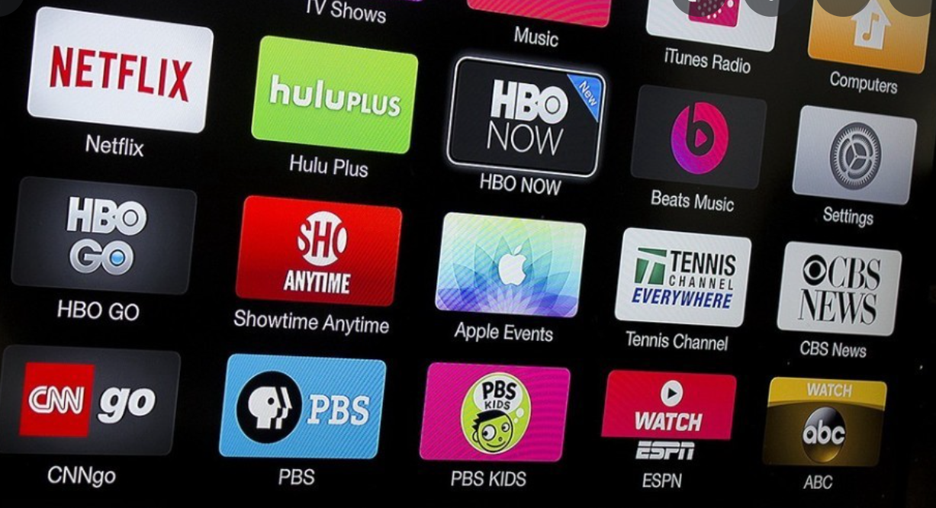

Streaming Services &
The Global Pandemic
At the end of 2019, the Coronavirus officially hit the U.S.
And became a global pandemic. By mid-March states
began issuing stay-at-home orders, and schools shut
down
Prior to 2019, there were a few major
streaming services. The most prominent being Netflix and Hulu. Now in 2022, there are over 30 in the U.S. alone.
During the global pandemic streaming services made an extremely large amount of money.
Hulu alone saw triple the amount
of revenue in 2020 from 2019.

